Slide 1
Inter-streaming Web Application
By G12

Slide 2
Created a video on demand applications with restricted access

Slide 3
The WebApp

Slide 4
Web Tools
NGINX
Scalyr
RTMP
JW Player
PHP
MYSQL
JavaScript & CSS
Thanks Google !!

Slide 5
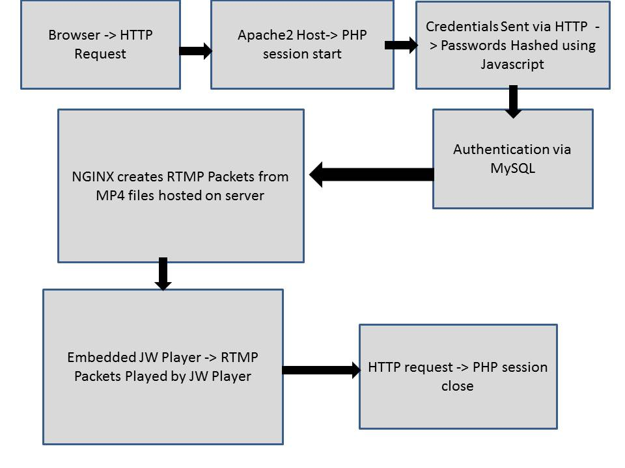
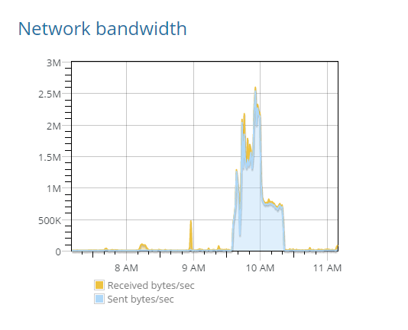
Application Flow Diagram

Slide 6
Analysis

Slide 7
How parameters get affected with increase in users

Slide 8
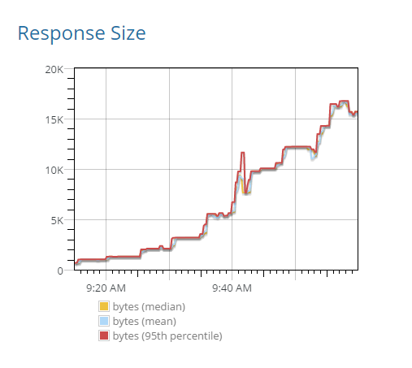
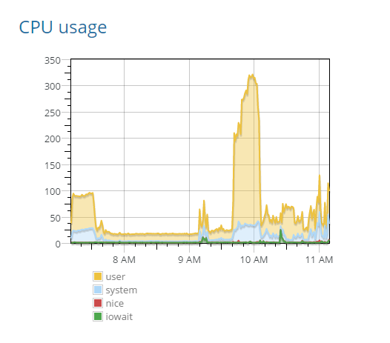
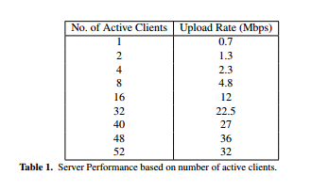
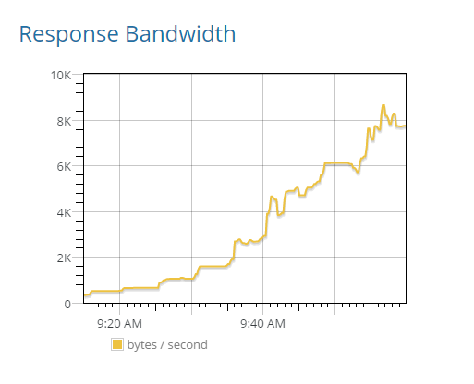
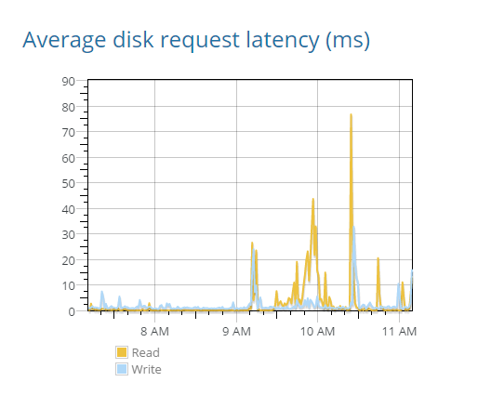

Slide 9


The experiment

Slide 10
Thank You !!

